Slide 1



Arowwai Industries
PRAKTIKUM PENGAUDITAN
Kholis Priwibowo - 12030122130120

Slide 2


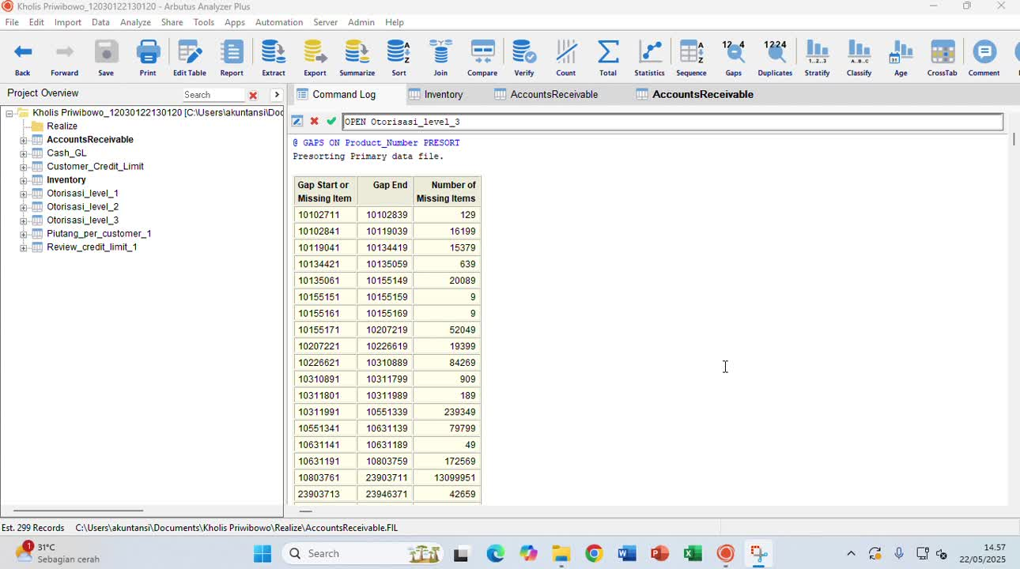


Command Log

Slide 3
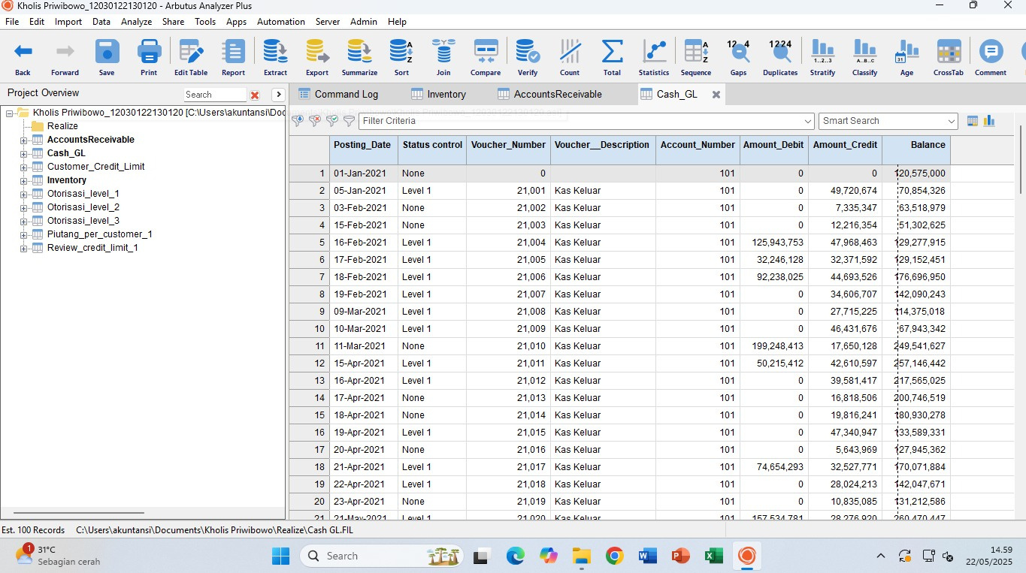
Cash_GL

Slide 4
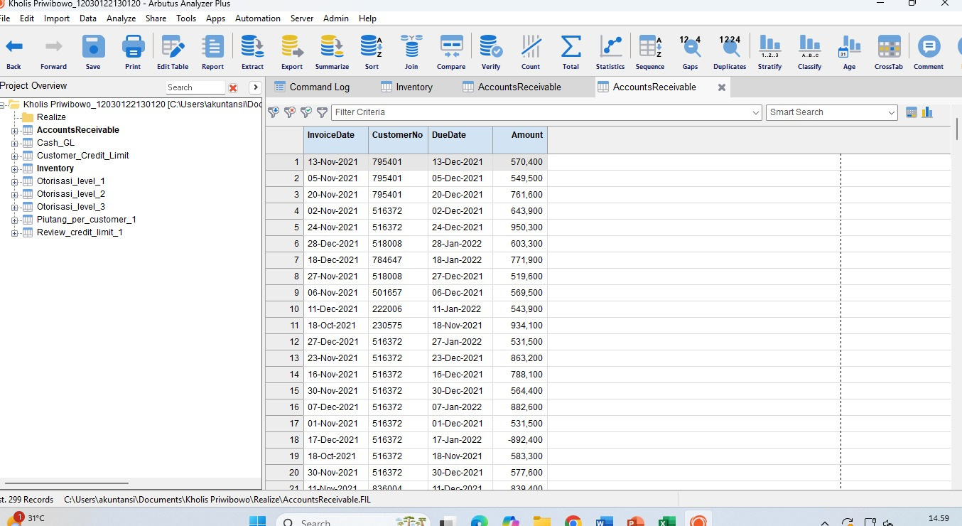
Inventory

Slide 5
Account Receivable

Slide 6
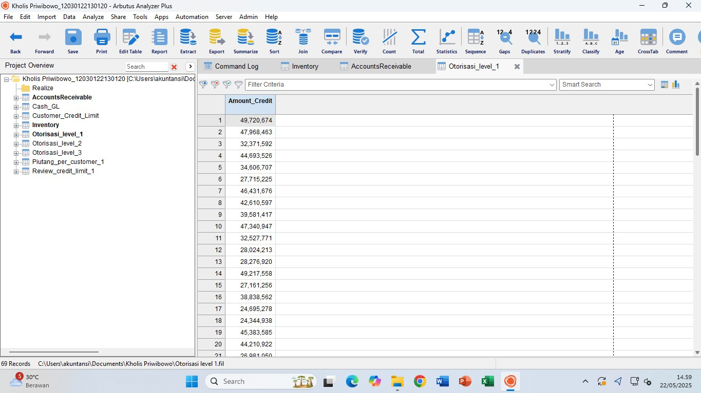
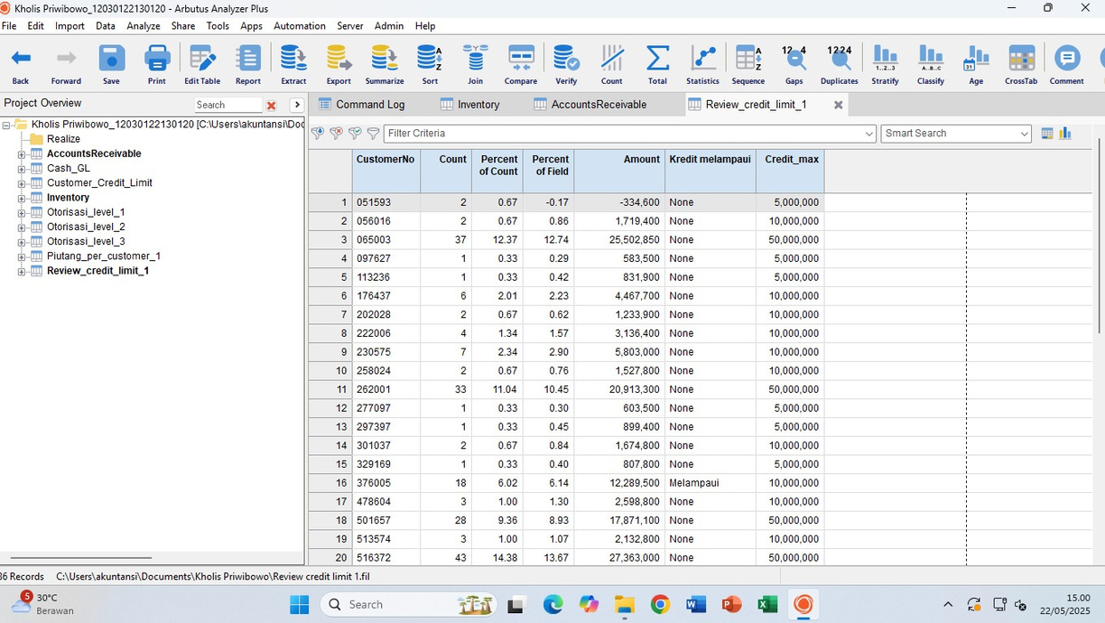
Otorisasi Level 1

Slide 7
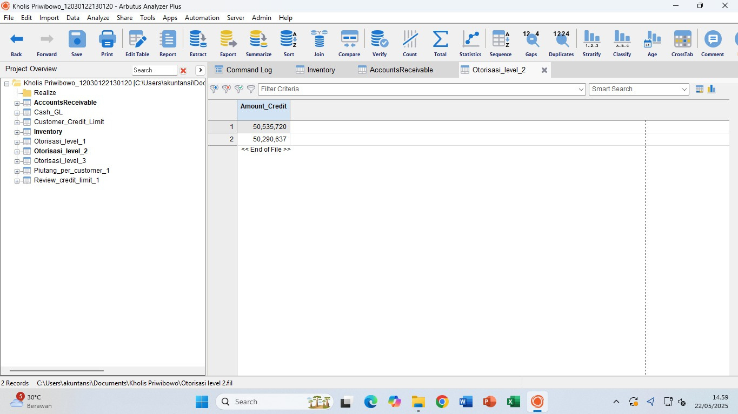
Otorisasi Level 2

Slide 8
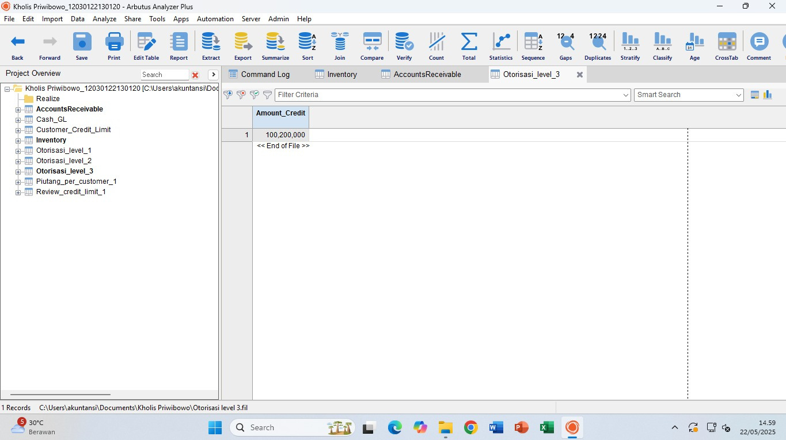
Otorisasi Level 3

Slide 9

Review Credit Limit

Slide 10
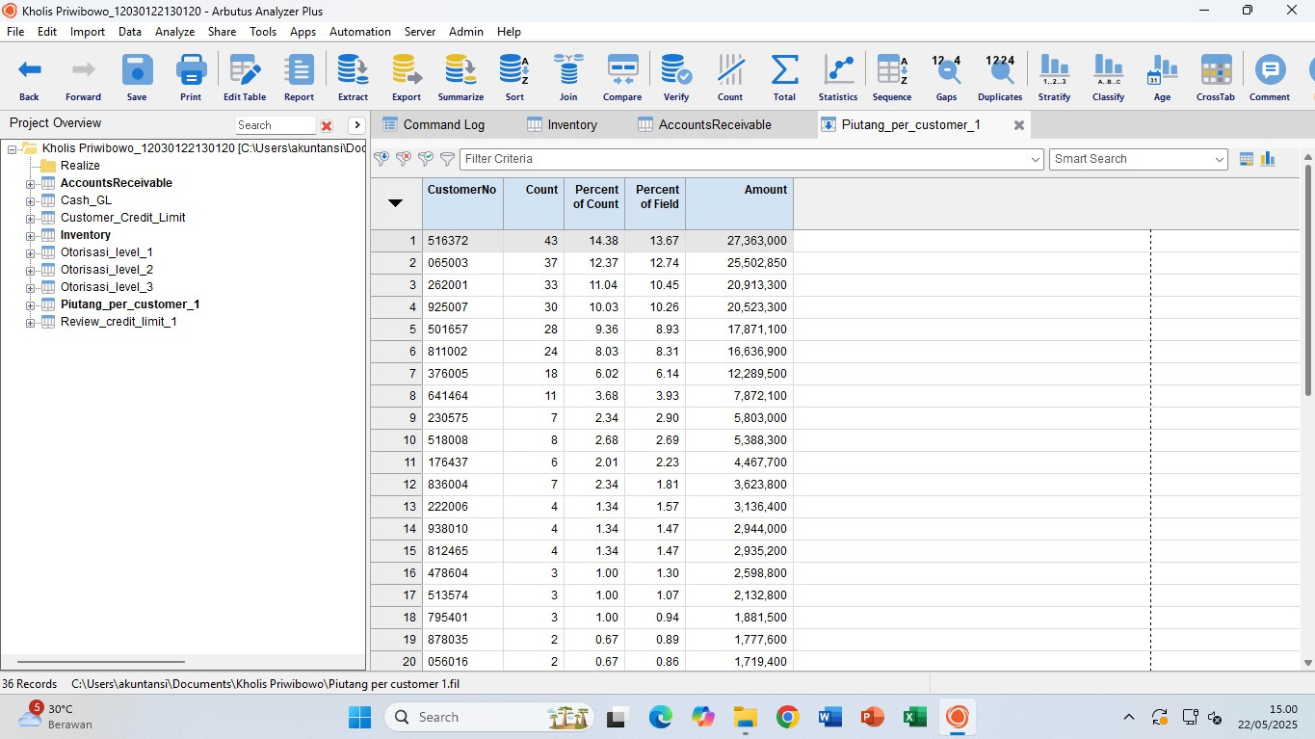
Piutang Per Customer

Slide 11
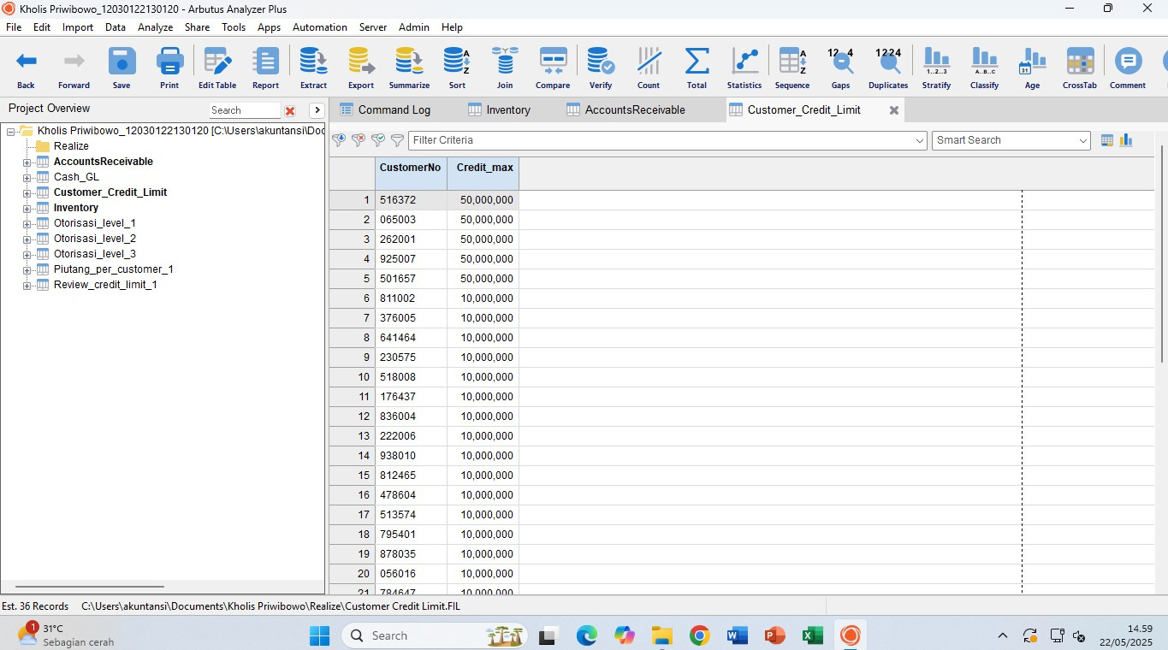
Customer Credit Limit

Slide 12





Thank You
Gerente General

